Slide 1
EXERCISE 3.6 Q.2(I)
No. 71

Slide 2


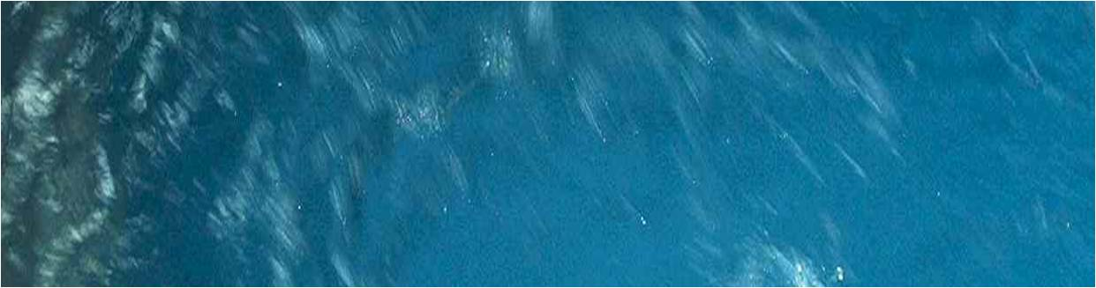
Ritu can row downstream 20 km in 2 hours, and
upstream 4km in 2 hours.
Find her speed of rowing in still water and the speed of the current.
Soln.
Stream means moving water or running water from higher level to lower level
And somebody opposes you with the speed of 2km / hr
Let Ritu’s speed in still water be x km/hr and the speed of current be y km/hr
Speed of the Boat in upstream = (x – y ) km / hr
Speed of the boat in downstream = (x + y) km / hr
Distance covered in downstream = 20 km
Time taken in down stream = 2 hrs
We Know that,
Speed = Distance
Time
x + y = 20
2
x + y = 10 ….(i)
Suppose you are moving with speed of 5 km/hr.
The boat and the stream travel in
opposite direction,
we say boat is moving upstream
Still water means the water which is not moving
The boat and the stream travel in same direction,
We say boat is moving Downstream
What will happen to your speed?
Distance travelled in upstream is
Eg : Swimming pool, pond etc
Solve the equations with either substitution or elimination method
What we need to find?
So in upstream the speed will increase or decrease??
In this question we come across two new terms
Upstream and Downstream
Distance travelled in downstream is
Similarly in upstream the speed of the boat Decreases
Eg : Sea, River etc
Speed Reduces
5 – 2 = 3 km/hr
Upstream
Speed increases
Distance covered in upstream = 4 km
Time Taken in upstream = 2 hrs
We Know that,
Downstream
x
= 6
Speed = Distance
Time
Substituting x = 6 in (i)
∴
∴
x - y = 4
2
y = 4
∴
∴
x - y = 2 ….(ii)
Speed of rowing in still water is 6 km/hr and speed of current is 4 km/hr

Slide 3
EXERCISE 3.6 Q.2(III)
No. 72

Slide 4
Roohi travels 300 km to her home partly by train and partly by bus.
She takes 4 hours if she travels 60 km by train by remaining by bus
If she travels 100 km by train and remaining by bus, she takes 10 minutes longer.
Find the speed of train and bus separately.
Total Distance = 300 km
Soln.
Total Distance = 300km
By train = 60 km
Hence,
by bus = 300 – 60 = 240 km
Let the speed of the train be x km/hr and the speed of the bus be y km/hr
Let us understand this sum in tabular form
Time = Distance
Speed
 | Train | Bus
Total Time = 4 hours
 | Train | Bus
She takes 10 minutes longer
10 minutes = 10 hrs
60
Distance
New time = 4 + 10
60
60 km
240 km
Distance
100 km
200 km
New time = 4 + 1 = 25 hrs
6 6
Speed
x km / hr
y km / hr
Speed
x km / hr
y km / hr
Time
60
x
hr
240
y
hr
Time
100
x
hr
200
y
hr
According to the first condition
According to the second condition
60
x
240
y
100
x
200
y
25
6
+
=
4
+
=
Dividing throughout by 4
Dividing throughout by 25
15
x
+
60
y
=
1
4
x
+
8
y
=
1
6
... (i)
... (ii)

Slide 5
ADDITIONAL EXAMPLE
No. 73

Slide 6

Lets understand the meaning of boat travelling upstream and downstream.
Speed of boat in upstream =
Speed of boat in still water – Speed of stream
Then speed of boat in downstream will be (x + y) km/hr
Then speed of boat in upstream will be (x – y) km/hr
If speed of boat in still water is 10 km/hr and speed of stream is 2 km/hr
Then speed of boat in upstream will be (10 – 2) = 8 km/hr
Speed of boat in downstream =
Speed of boat in still water + Speed of stream
If speed of boat in still water is 10 km/hr and speed of stream is 2 km/hr
Boat travelling against the flow of stream is called Upstream
Then speed of boat in downstream will be (10 + 2) = 12 km/hr
If speed of boat in still water is x km/hr
Boat travelling with the flow of stream is called Downstream
If speed of boat in still water is x km/hr
If speed of stream is y km/hr
If speed of stream is y km/hr

Slide 7
No. 74

Slide 8
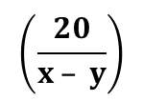





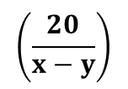

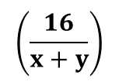
(Q)
A boat takes 6 hours to travel 8 km upstream and 32 km downstream, and it takes 7 hours to travel 20 km upstream and 16 km downstream.
Find the speed of the boat in still water and the speed of the stream.
Sol.
Let the speed of the boat in still water be x km/hr and the speed of the stream be y km/hr.
What we need to find?
Let us assume that
Speed of boat in upstream will be (x – y) km/hr
Total time is 6 hours
Total time is 7 hours
Upstream
Downstream
Distance
8 km
32 km
Speed of boat in downstream will be (x + y) km/hr
20 km
16 km
Speed
(x – y) km/hr
(x + y) km/hr
$$\left(\frac{20}{x – y}\right)$$
$$\left(\frac{16}{x+y}\right)$$
= $\frac{Distance}{Speed}$
$$\left(\frac{8}{x−y}\right)$$
$$\left(\frac{32}{x+y}\right)$$
Time
hrs
hrs
We know that
As per the first given condition,
As per the second given condition,
$$\left(\frac{8}{x−y}\right)$$
$$\left(\frac{32}{x+y}\right)$$
$$\left(\frac{20}{x−y}\right)$$
$$\left(\frac{16}{x+y}\right)$$
+
=
6
........(i)
+
=
7
........(ii)

Slide 9














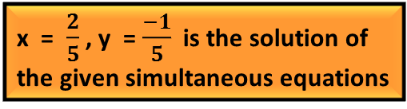



(Q)
A boat takes 6 hours to travel 8 km upstream and 32 km downstream, and it takes 7 hours to travel 20 km upstream and 16 km downstream.
Find the speed of the boat in still water and the speed of the stream.
Substituting $\frac{1}{x −y}=m and \frac{1}{x+ y}=n$in (i) and (ii) we get
=$\frac{1}{x −y}$
$$\left(\frac{32}{x+y}\right)$$
=$\frac{1}{x + y}$
Sol.
$$\left(\frac{8}{x−y}\right)$$
$$\frac{1}{4}$$
+
$$\frac{1}{8}$$
=
6
........(i)
8m + 32n = 6
…. (iii)
Substituting m = $\frac{1}{4}$in (iii),
20m + 16n = 7
…. (iv)
$$x−y$$
= 4 ….(vi)
$$x+y$$
= 8 ….(vii)
$$\left(\frac{1}{4}\right)$$
$$\left(\frac{20}{x−y}\right)$$
$$\left(\frac{16}{x+y}\right)$$
+
=
7
........(ii)
Multiplying (iv) by 2, we get
8
+ 32n
= 6
Adding (vi) and (vii),
x – y = 4
40m + 32n = 14
…. (v)
∴
2 + 32n
= 6
x + y = 8
Subtracting (iii) from (v)
∴
32n
= 6 – 2
2x = 12
40m + 32n = 14
∴ x = $\frac{\text{12 }}{\text{2} }$
∴
32n
= 4
8m + 32n = 6
∴
= $\frac{\text{4}}{\text{32}}$
∴ x = 6
(–) (–) (–)
n
Substituting x = 6 in (vii)
32m
= 8
6
+
y
8
= $\frac{\text{1}}{ \text{8} }$
=
∴
n
∴
y
=
8
–
∴ m = $\frac{ \text{8 }}{\text{32}}$
6
∴
y = 2
Resubstituting the values of m and n we get,
∴ m = $\frac{1}{4}$
∴ The speed of boat in still water is 6km/hr and speed of stream is 2km/hr

Slide 10
EXERCISE 3.5 Q.4(III)
No. 75

Slide 11
Yash scored 40 marks in a test, getting 3 marks for each right answer and losing 1 mark for each wrong answer.
Had 4 marks been awarded for each right answer and 2 marks deducted for each wrong answer,
then Yash would have scored 50 marks.
How many question were there in the test?
What we need to find?
Soln.
Let number of right answers be x and wrong answer be y
According to first condition,
According to second condition,
3x
-
1y
=
40
….(i)
4x
-
2y
=
50
….(ii)
Some answer were right and some were wrong
 | Marks awarded for Right answer | Marks deducted for Wrong answer | Total
Condition I
3x
1y
40
Condition II
4x
2y
50

Slide 12
ADDITIONAL EXAMPLE
No. 76

Slide 13
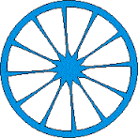
If circumference is x m and it increases by 1/4,
then new circumference will be
Distance covered by wheel in 1 revolution
= 1 × Circumference
Distance covered
= No. of revolutions × Circumference
Distance covered by wheel in 2 revolution
= 2 × Circumference
Distance covered
No. of revolutions =
Distance covered by wheel in n revolution
= n × Circumference
Circumference
We know that,
Original circumference + increase in circumference
Circumference
= π × Diameter
1
Since π is a constant value,
means circumference changes as the diameter changes
∴ New circumference =
x
+
(x)
4
If diameter of wheel is increase,
4x + x
then its circumference will also increase.
=
4
If diameter increase by half, then circumference also increases by half
5x
If a wheel makes 1 revolution
=
4
If diameter increase by 1/4, then circumference also increases by 1/4
Distance covered by wheel in 1 revolution is

Slide 14
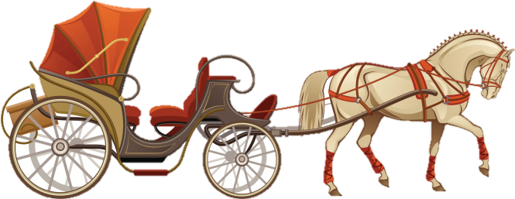

Q. The fore wheel of a carriage makes 6 revolutions more than the rear wheel in going
120m. If the diameter of the fore wheel be increased by ¼ its present diameter and the
diameter of the rear wheel be increased by one-fifth of its present diameter, then the
fore wheel makes 4 revolutions more than the rear wheel in going the same distance.
Find the circumference of each wheel of the carriage.
Sol.
Let the circumference of fore wheel be x m & rear wheel be y m.
Circumference of fore wheel & rear wheel
Distance covered
How to find no. of revolutions?
Fore wheel
Rear wheel
No. of revolutions =
Circumference
Circumference
x m
y m
Distance
120 m
120 m
No. of Revolutions =
120
120
Distance covered
Fore wheel makes 6 more revolutions than rear wheel
120 m
Circumference
x
y
As per the first condition,
120
120
120
120
=
+ 6
–
= 6
…(i)
x
y
x
y

Slide 15
Q. The fore wheel of a carriage makes 6 revolutions more than the rear wheel in going
120m. If the diameter of the fore wheel be increased by ¼ its present diameter and the
diameter of the rear wheel be increased by one-fifth of its present diameter, then the
fore wheel makes 4 revolutions more than the rear wheel in going the same distance.
Find the circumference of each wheel of the carriage.
If diameter increases by ¼ , then circumference also increases by ¼
120
120
If diameter increases by 1/5, then circumference also increases by 1/5
–
= 6
…(i)
Sol.
Let the circumference of fore wheel be x m & rear wheel be y m.
x
y
Distance covered
New circumference =
Original circumference + increase in circumference
Distance covered
Fore wheel
Rear wheel
New circumference =
Original circumference + increase in circumference
20
No. of revolutions =
24
Circumference
120 × 4
120 × 5
100
Circumference
5x
6y
Circumference
96
=
=
Lets solve these 2 equations
4
5x
5
6y
y
x
1
Distance
120 m
120 m
1
∴ New circumference =
∴ New circumference =
x
+
(x)
y
+
(y)
4
5
No. of Revolutions =
5y + y
120
96
120
100
=
4x + x
Distance covered
=
=
=
4
5x
x
6y
y
5
Circumference
( )
( )
4
5
5x
=
6y
=
As per the second condition,
4
5
96
100
96
100
=
+ 4
–
= 4
…(ii)
x
y
x
y

Slide 16






Substituting $\frac{1}{x}$ = a and $\frac{1}{y}$ = b in (i) and (ii)
∴ 5
– 20b = 1
120
120
∴ – 20b
= 1 – 5
–
= 6
…(i)
Since variables are in denominator lets remove it by substitution
x
y
20a – 20b = 1 ...(iii)
Lets make coefficient of b equal
96a – 100b = 4 …(iv)
∴ – 20b
= – 4
96
100
–
= 4
…(ii)
Multiplying (i) by 5 we get,
∴ b = $\frac{1}{5}$
x
y
100a – 100b = 5 …(v)
Resubstituting the values of a and b
Subtracting (v) from (iv)
a =$\frac{1}{x}$
b =$\frac{1}{y}$
96a – 100b = 4
100a – 100b = 5
$\frac{1}{4}$ = $\frac{1}{x}$
$\frac{1}{5}$ = $\frac{1}{y}$
(–) (+) (–)
∴
∴
– 4a = – 1
∴ x = 4
∴ y = 5
∴ a = $\frac{1}{4}$
∴
Circumference of fore wheel is 4m and circumference of rear wheel is 5m
Substituting a = $\frac{1}{4}$in (iii),
$$\left(\frac{1}{4}\right)$$
20
– 20b = 1

Slide 17
Thank You

